Slide 1
Software product management Product development in the enterprise
Nandagopal Govindan

Slide 2
Contents

Slide 3
How is product management different for the enterprise?
Products are usually specialized focused on an industry
Example: SAP, Shopify, AutoDesk, Navitaire (airline reservation)
User vs buyer:
Buyers are interested in solving a business problem and user is interested in specific functionality and ease of use.
Example of a business problem: “We are facing intense downward pricing pressure from a smaller competitor who is trying to steal market share, and we’re are looking for new ways to engage with our own customers to stem attrition.”
Testing: A/B testing is not usually used due to the impact on enterprise customers
Development model: More waterfall than Agile. Ex. PayMe
Release cycles are longer.
Paypal has 2 month release cycles

Slide 4
Innovators dilemma
(Book by Clayton Christensen)
Large organization are worried about impact on current business. Kodak did not accept the digital camera innovation,
Disruptive innovation is ignored by enterprises:
Enterprise focus is on steady revenue month on month.
But startup innovators have no such expectations.
Initially the disruptive innovation is small and unpolished, the customers using it are small in number.
But it grows gradually and by the time it is noticed by the enterprise, the innovator is far ahead to catchup
Example:
IBM was late to enter Cloud services
SalesForce offered an innovative CRM on the cloud and the large companies kept ignoring the opportunity

Slide 5

Case study: Overcoming opposition to new ideas – Alex Pressland, BBC

Slide 6

Case study: Developing product in Enterprise

Slide 7
How enterprises can innovate?
3-Box solution by Vijay Govindarajan ex-Prof at Harvard
(https://www.youtube.com/watch?v=wgD2VzFqCaE)

Slide 8
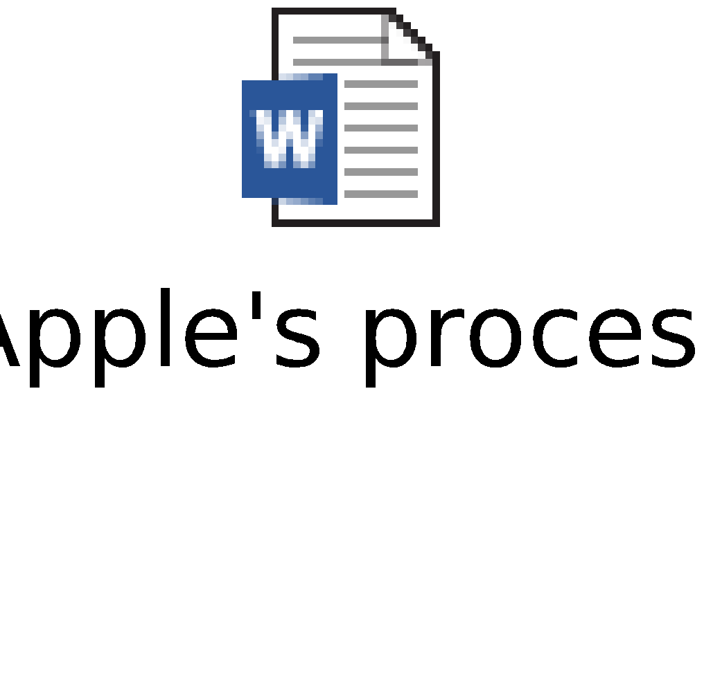
Apple’s product development process

Slide 9

Google: A day in the life of a Product Manager

Slide 10

Innovation value chain
A process to innovate in the enterprise

Slide 11
Appendix

